Slide 1
Reception to Year 1 Transition Information

Slide 2
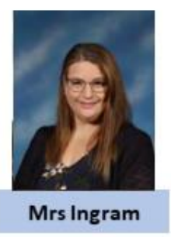
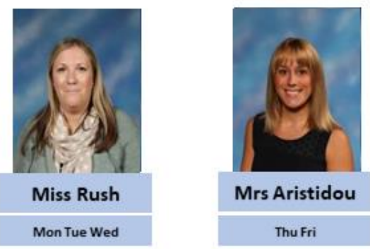
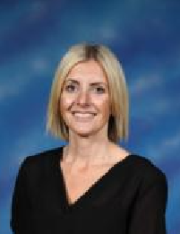
Meet the Year 1 teachers…
Year Group Lead
They are very excited you are joining their classes. You will have lots of fun learning together!

Slide 3
Moving from Reception into Year 1 feels like a big change …
We aim to make it a smooth and easy transition so your children feel happy and confident.

Slide 4
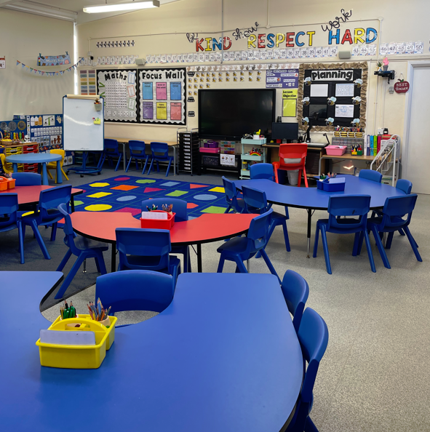
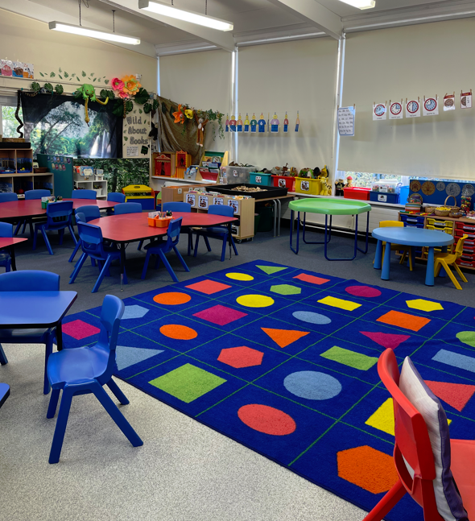
The Year 1 day is very similar to the Reception day. In Reception children have gradually been working at more structured and Year 1 style activities. This helps them to be ready for the Year 1 curriculum.

Slide 5
We will continue to have daily RWInc lessons – Fred Frog will still help us!
Please listen to your child read at home 5x weekly.

Slide 6
We will continue to learn the Special Friends.

Slide 7
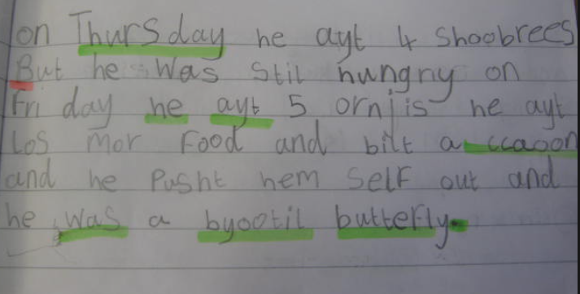
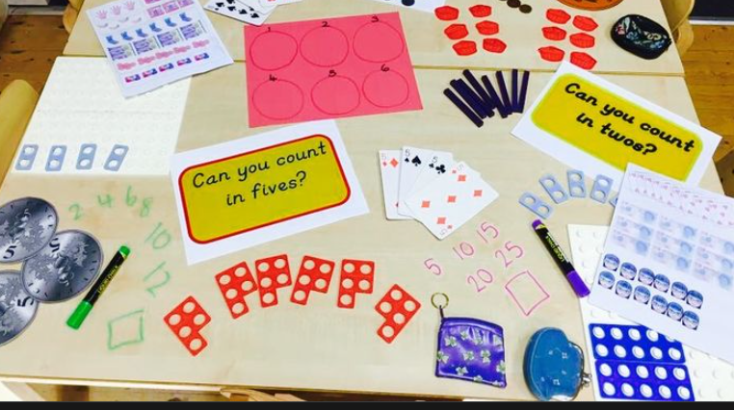
Morning Timetable
This is slightly more structured than Reception in that everyone has the same lesson at the same time.
RWInc
Writing
Maths
We use lots of practical resources to help us learn and investigate new topics and concepts.

Slide 8
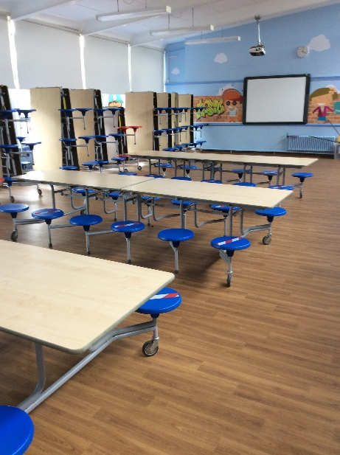
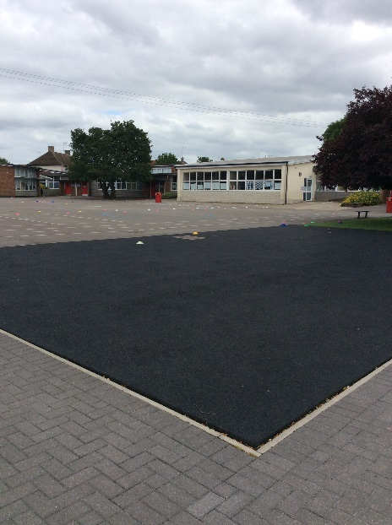
You will continue to eat your lunch in the dinner hall. You will have a choice of a hot dinner or a cold lunch, or you can bring in your own packed lunch. Your teacher and Midday Supervisors will look after you. You will play on the KS1 playground with your friends when you have finished your lunch. Just like when you were in Reception. Even lots of the grown ups will be the same!
Lunchtimes
Dining Hall
KS1 Playground

Slide 9
Afternoon Timetable
The afternoons run in a very similar way to Reception. There is a mixture of whole class and hands on learning. There are lots of opportunities to learn through play based activities. Teachers work with small groups of children during these sessions.
Once a week they will have a whole day of topic based work.

Slide 10
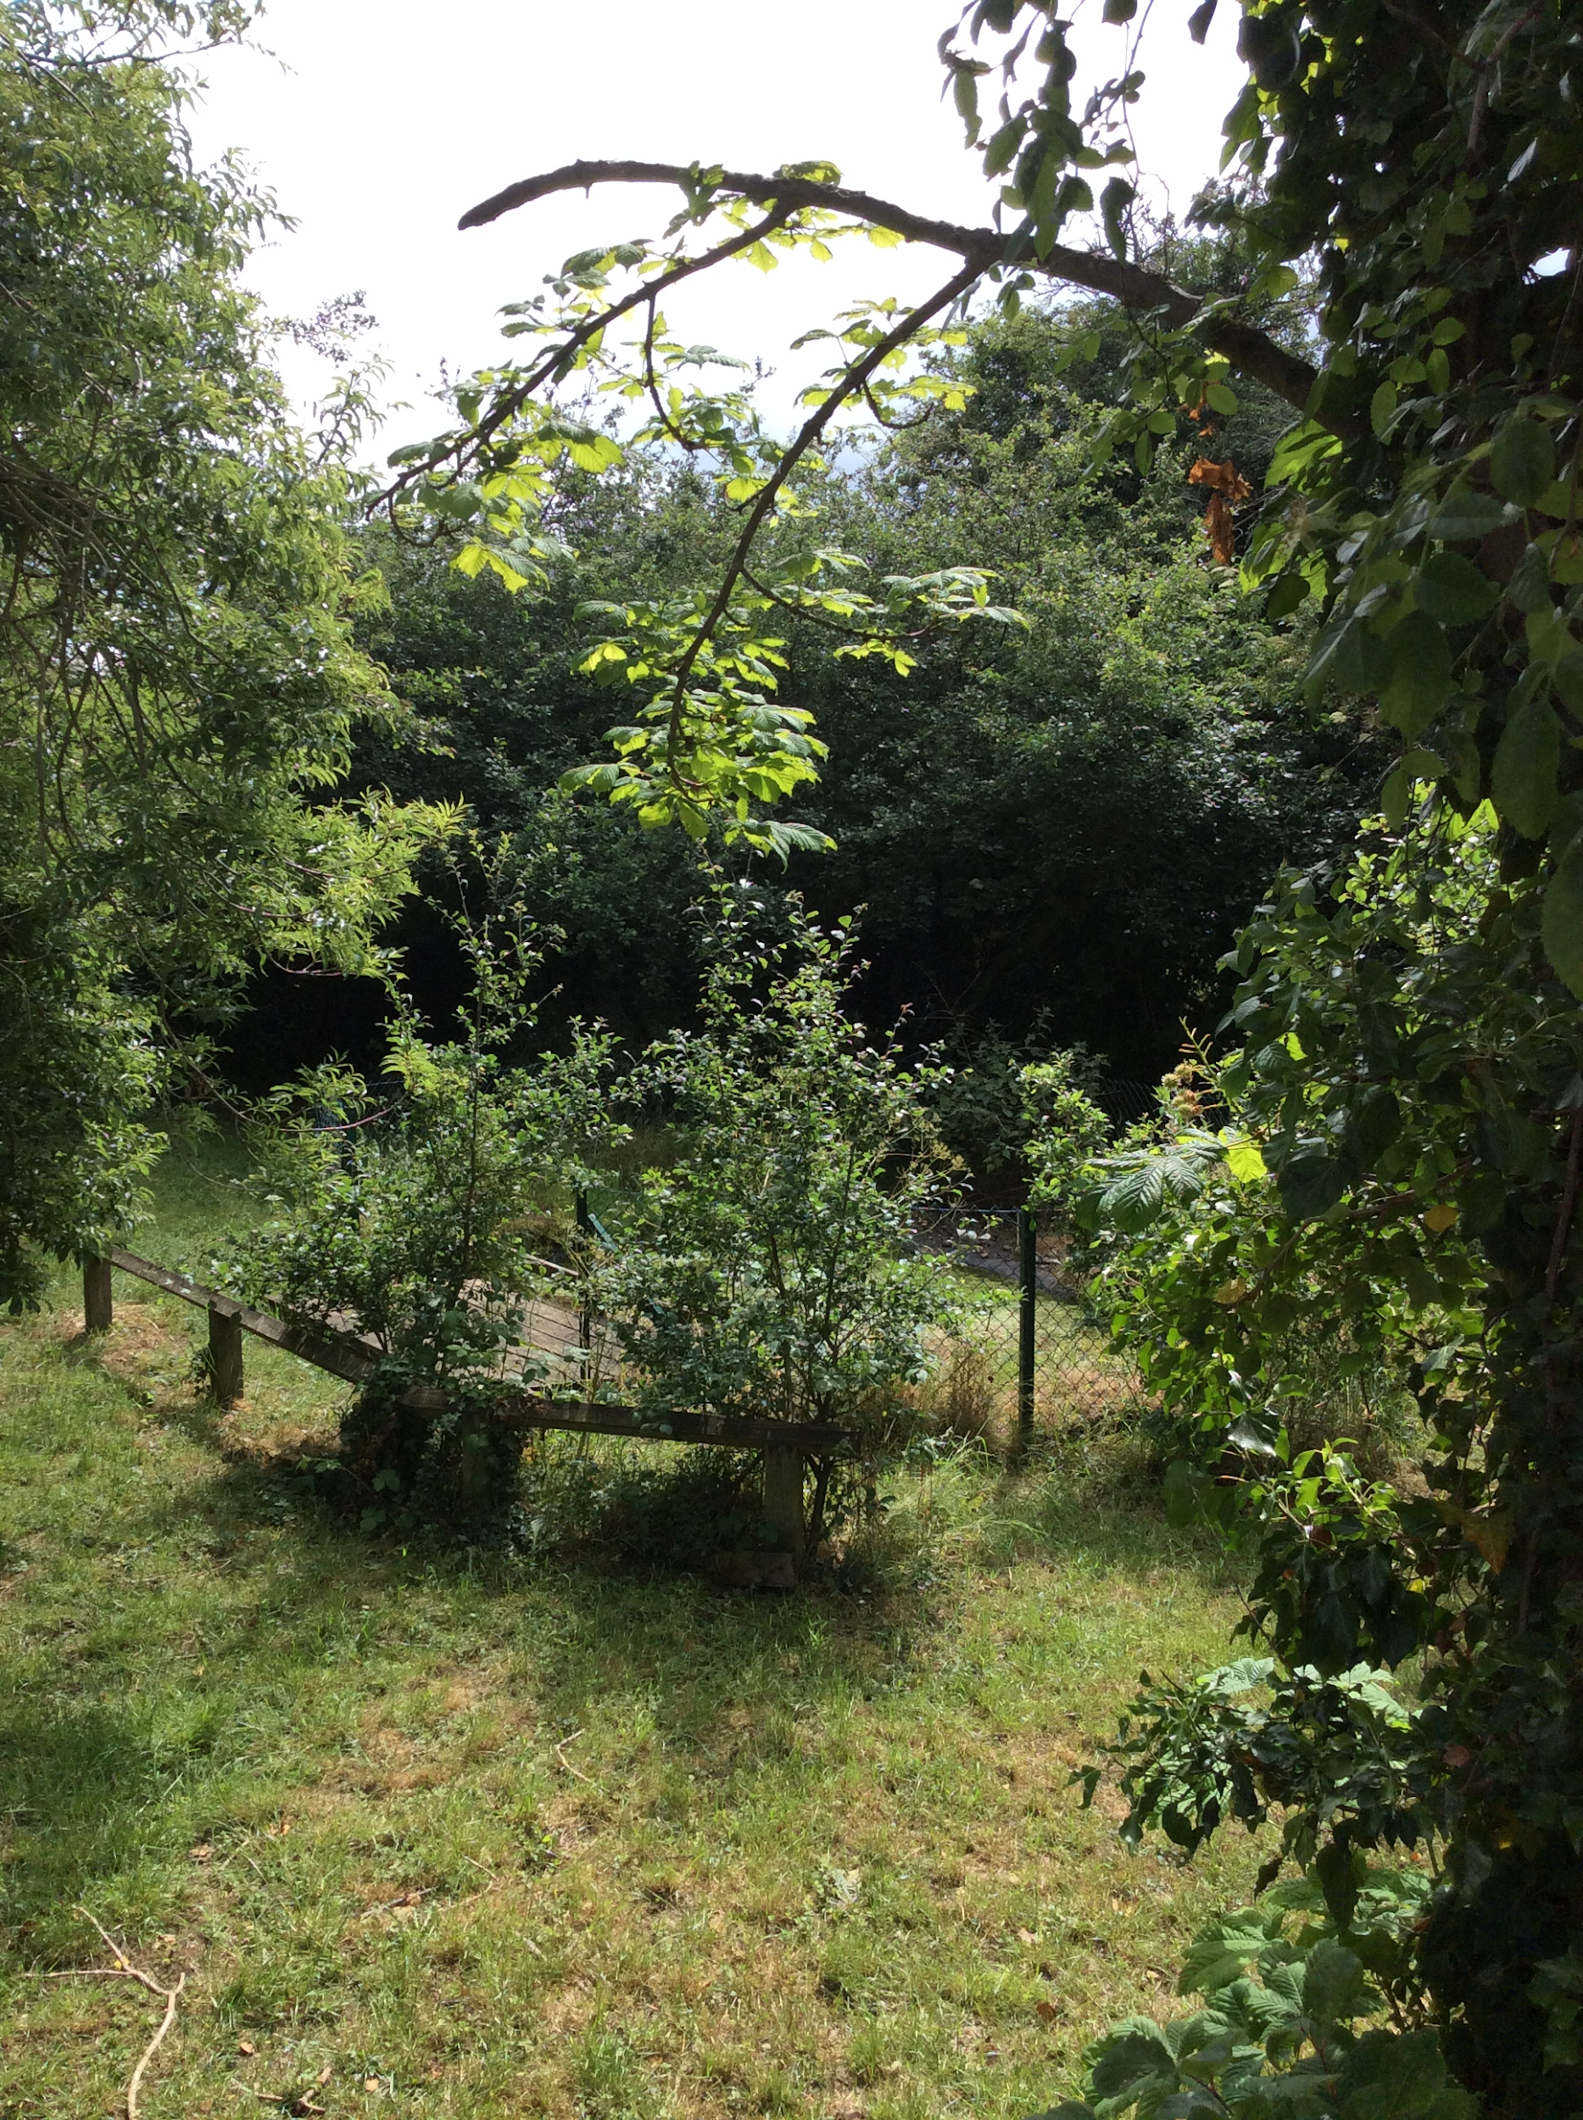
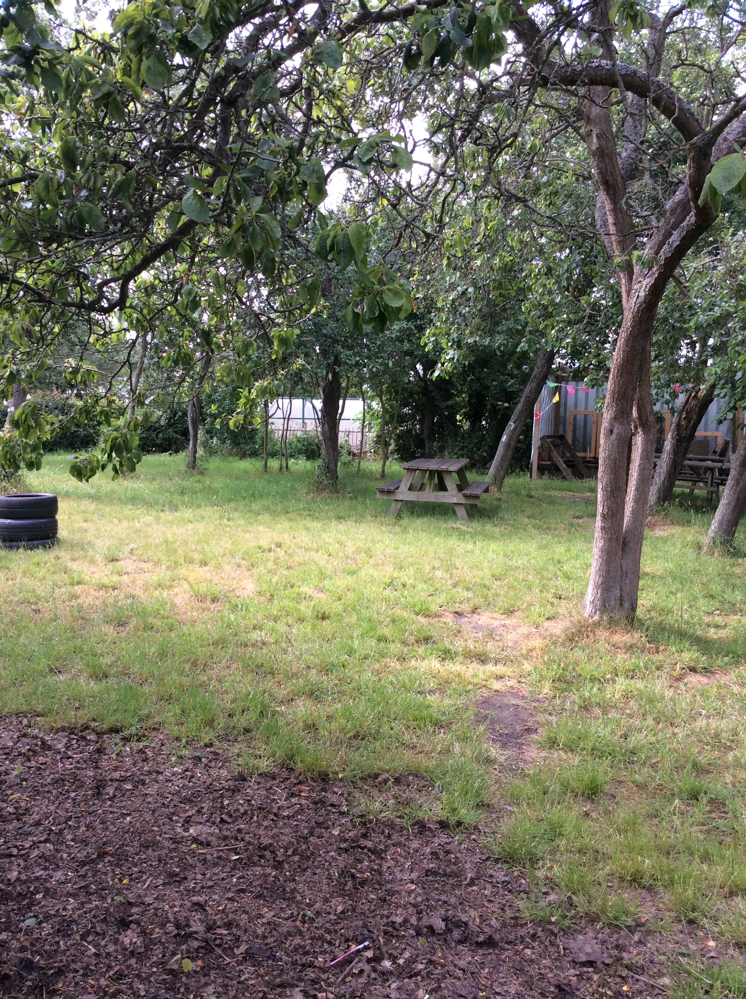
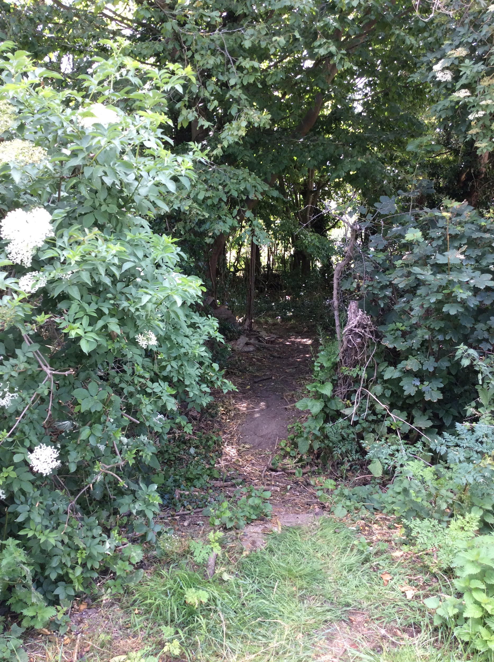
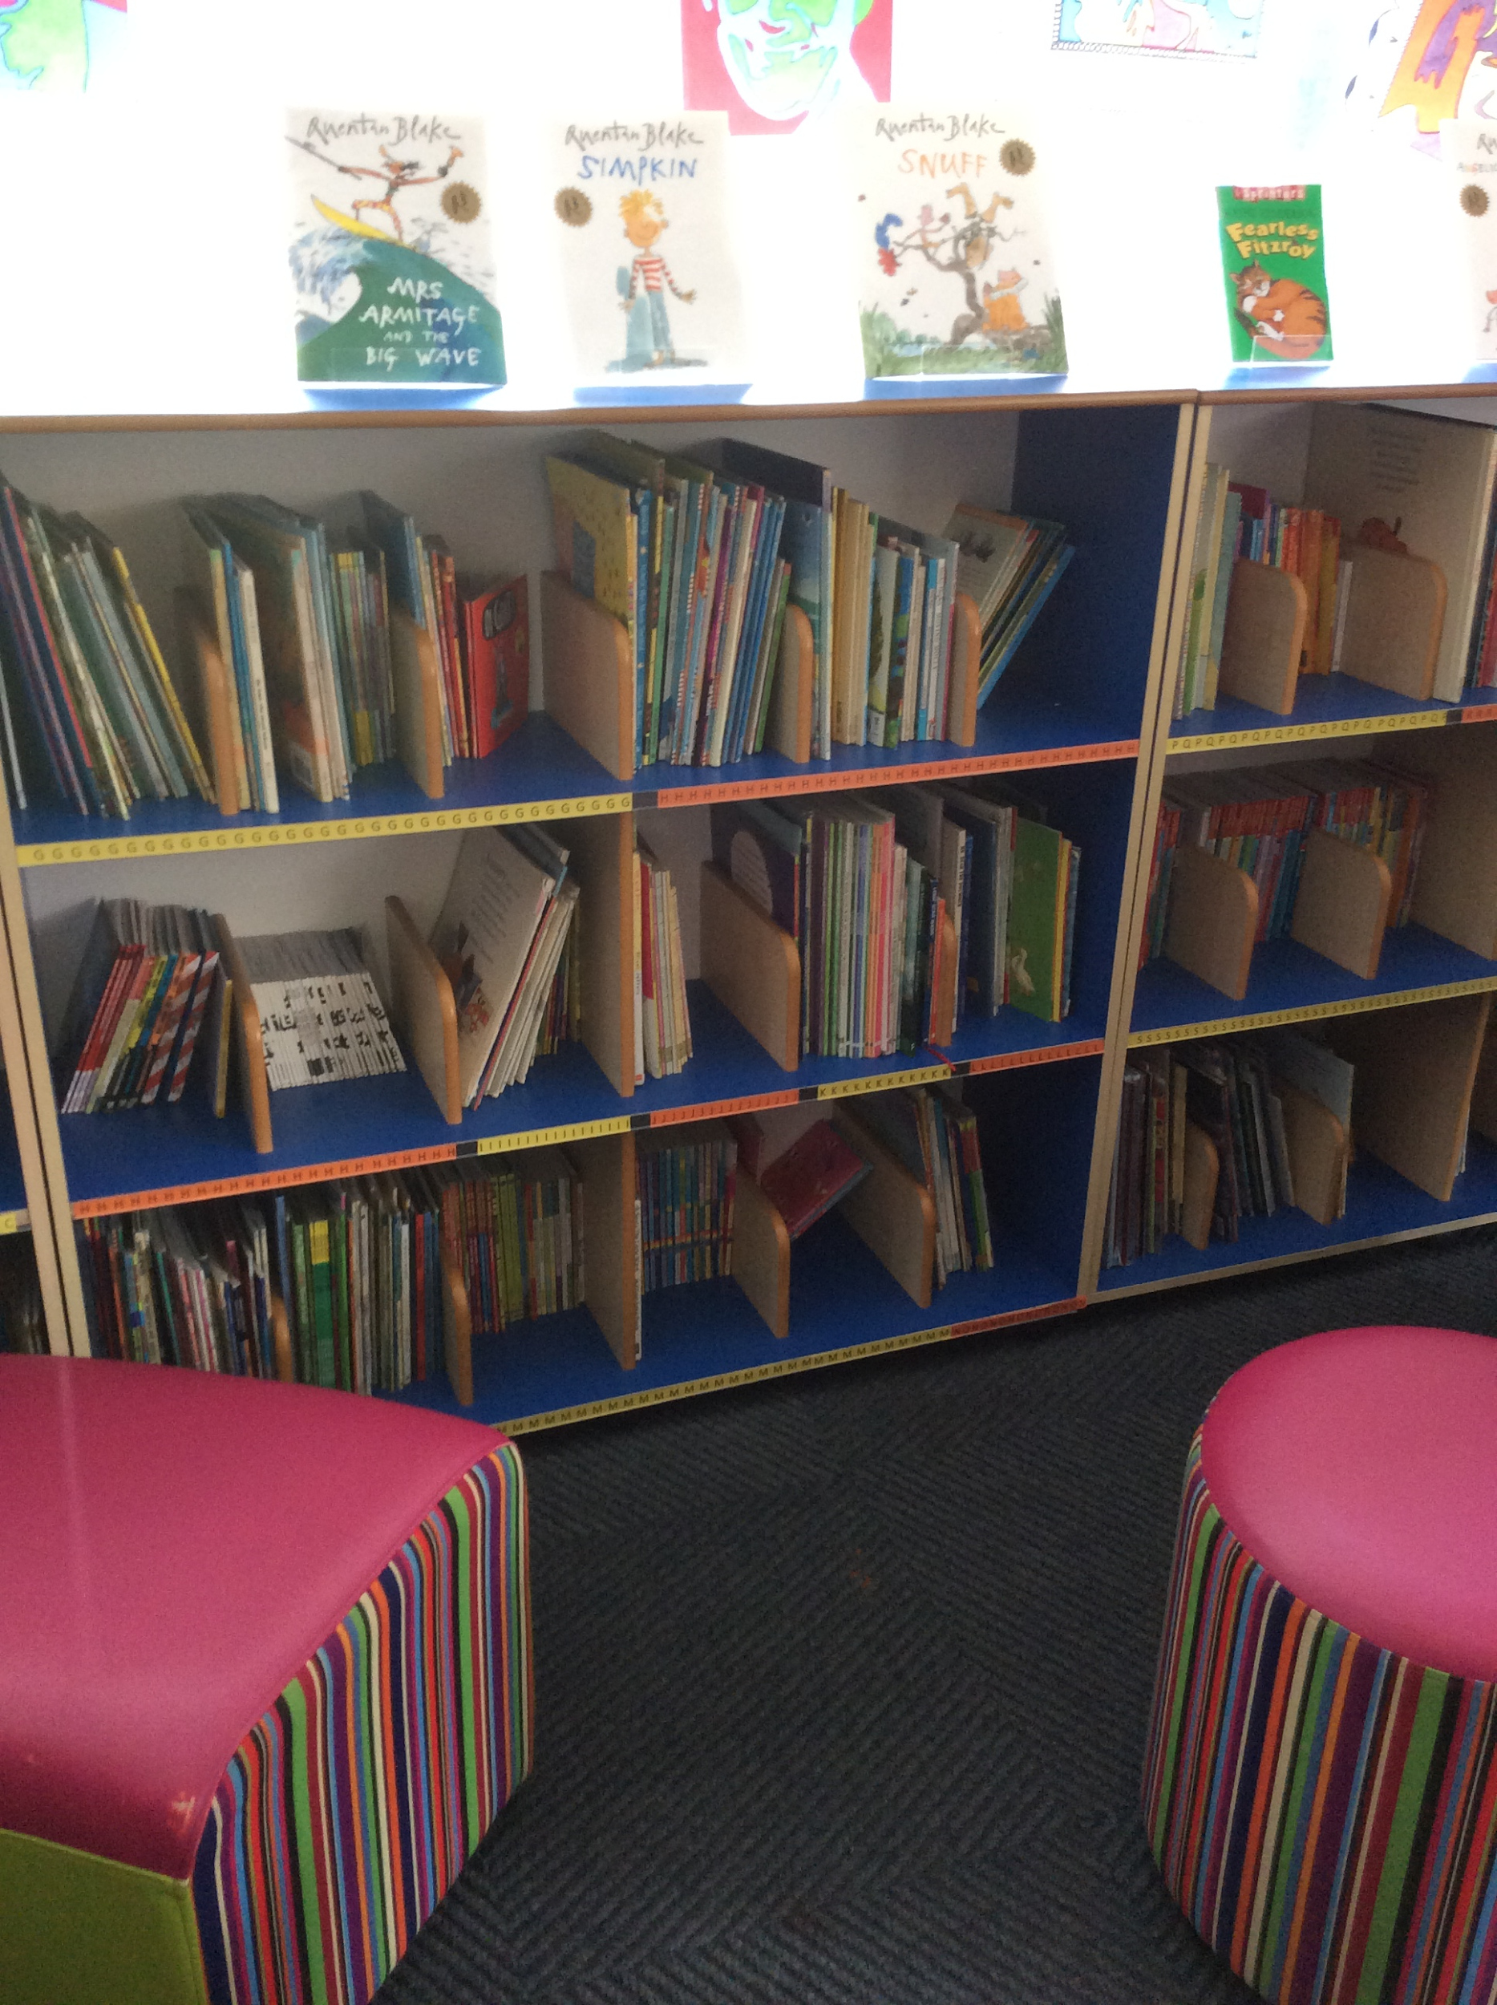
We are so lucky to have lots of wonderful spaces which we use for our learning.
Other school areas for learning
Pond area
Secret Garden
Wildlife area
EYFS and KS1 Library

Slide 11
Transition
We are working hard to make sure this transition is a smooth and happy one.
The Year 1 teachers are coming into our the Reception classes as much as possible throughout the next 2 weeks. They will be reading stories and getting to know the children.

Slide 12
If there is anything else you want to know, just get in touch! We are always here and please do ask if you have any questions or concerns.

